Slide 1

Collaborative scripting for NGS analysis
You can change this image to be appropriate for your topic by inserting an image in this space or use the alternate title slide with lines. Note: only one image should be used and do not overlap the title text.
Enter your Business Unit or Flagship name in the ribbon above the url.
Add collaborator logos in the white space below the ribbon.
[delete instructions before use]
By restlessglobetrotter
CMIS
Denis C. Bauer | Research Scientist, CMIS
16 November 2012
CMIS

Slide 2
Production Informatics and Bioinformatics
Product | Time
fastq | 5 days
bam, vcf,… | 3 weeks
paper | >6 months
Produce raw sequence reads
Basic Production
Informatics
Map to genome and generate raw genomic features (e.g. SNPs)
Advanced
Production Inform.
Analyze the data; Uncover the biological meaning
Bioinformatics
Research
Per one-flowcell project

Slide 3
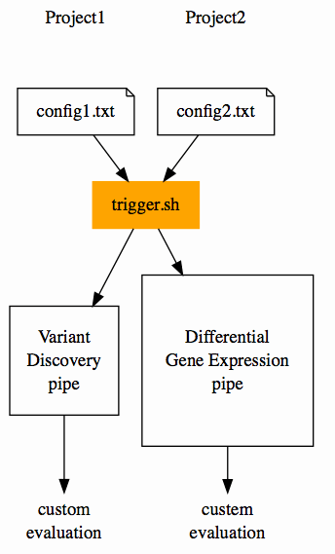
Aim: Reduce Set-up-overhead
Package so that the overhead for setting up a project is minimal
However, different projects require different tools, so flexibility needs to be provided.
automatic

Slide 4
Bundle Tasks in Modules: <module>.sh
Input
(e.g. line.fastq)
Modular conceptual blocks
Plug & Play
Contribution from users
bwa aln
bwa sampe
samtools index
dedup
…
Raw
reads
Variants
Raw
reads
TFBS sites
Output
(e.g. line.bam)
Raw
reads
Transcripts

Slide 5
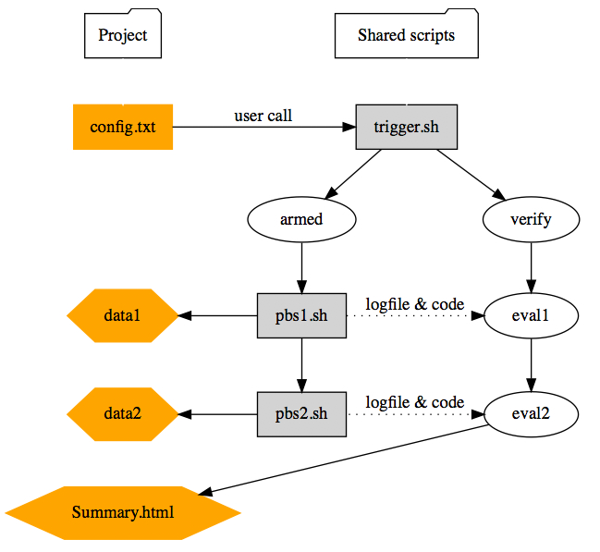
Start/evaluate pipeline: Trigger.sh
Keeping data separate from scripts
Automating verification, quality control and summary HTML generation
Rerunning pipeline from every point

Slide 6
Project-specific parameters: Config.txt
#********************
# Tasks
#********************
RUNMAPPINGBWA="1"
RUNREALRECAL="1"
#********************
# Paths
#********************
FASTA="$DATASTORE/resources/hg19/hg19.fasta"
DBSNP="$DATASTORE/resources/hg19/snpdb132.vcf"
#********************
# PARAMETER
#********************
LIBRARY=”RNAseqObeseVsLean”
ADDPARAMBWA=“--force single”
Specifics what to do,
e.g. mapping and recalibration
Specifics where to find resources
Customizes standard scripts for this project

Slide 7
Flexible generic defaults: header.sh
#********************
# Programs
#********************
BWA="module load bwa/2.0.1"
BEDTOOLS="$DATASTORE/apps/bedtools"
#********************
# Names & Types
#********************
TASKBWA="bwa"
READONE="R1"
FASTQ="fastq.gz"
#********************
# Resources
#********************
WALLTIME_BOWTIE=10:00:00
MEMORY_BOWTIE=60
NODES_BOWTIE="nodes=1:ppn=8"
Program paths or modules to use
Default names and endings
Typical resource usage for each tool

Slide 8
Use example: 3 Steps
1) Set up config.txt file
RUNMAPPINGBWA="1"
FASTQ="fastq"
FASTA="$DATASTORE/resources/hg19/hg19.fasta"
2) Test what it does
> trigger.sh config.txt
3) Submit jobs
> trigger.sh config.txt armed
Spawn len(*.fastq) parallel jobs

Slide 9
Folder-structure after trigger.sh call
Fastq
Sub1
Sub2
qout
bwa
reCaAl
Variants
Sub2
Sub1
Bwa
reCaAl
Bwa
reCal
Project
Summary
s_1_read1.fastq
s_1_read2.fastq
s_2_read1.fastq
s_2_read2.fastq
s_3_read1.fastq
s_3_read2.fastq
s_4_read1.fastq
s_4_read2.fastq
Sub1_s_1.out
Sub1_s_2.out
Sub2_s_3.out
Sub2_s_4.out
Sub1_s_1.out
Sub1_s_2.out
Sub2_s_3.out
Sub2_s_4.out
s_1.bam
s_2.bam
s_1.ashrr.bam
s_2.ashrr.bam
s_3.bam
s_4.bam
s_3.ashrr.bam
s_4.ashrr.bam
4) Validate and summarize outcome
> trigger.sh config.txt html

Slide 10
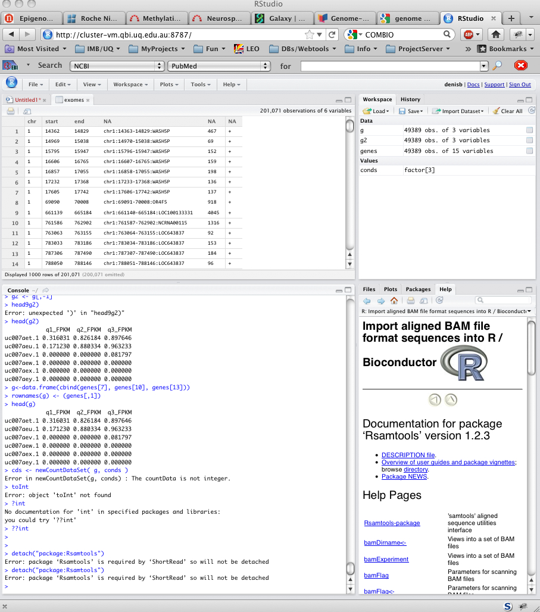
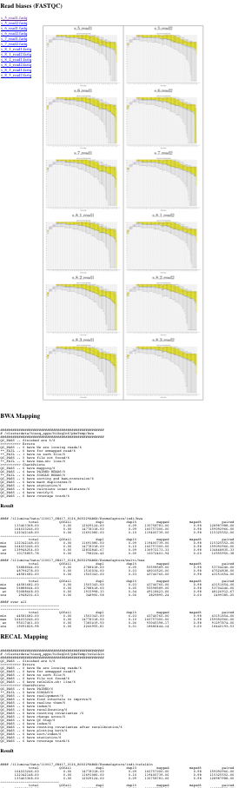
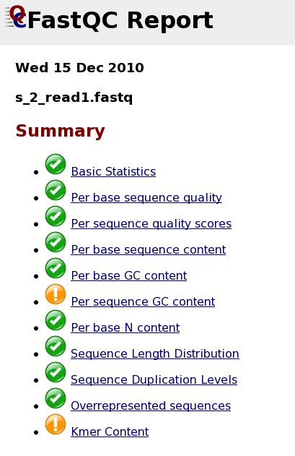
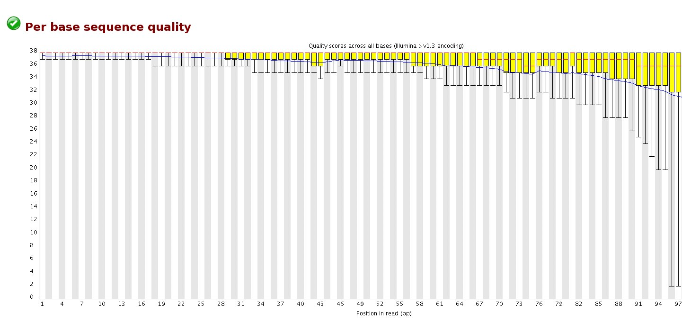
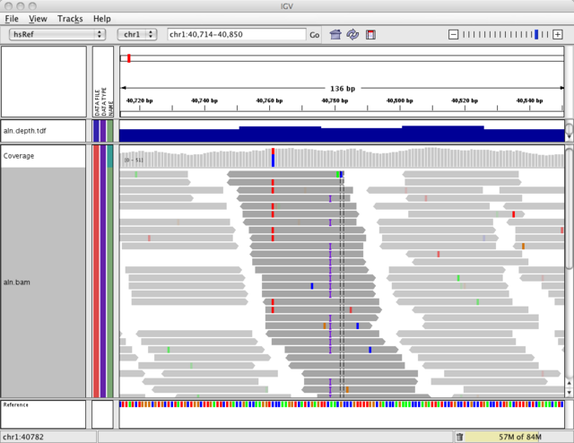

Summary.html (Project Cards)
Sequence statistics
Run check
points
Data Visualization
Mapping stats
Download

Slide 11
Scaffold of pbsScripts.sh: Error catching
Code example for setting up what errors to look out for
# QCVARIABLES, loosing reads, unmapped read,no such file,file not found,bwa.sh: line
Output in Summary.html
>>>>>>>>>> Errors
QC_PASS .. 0 have We are loosing reads/184
QC_PASS .. 0 have for unmapped read/184
QC_PASS .. 0 have no such file/184
QC_PASS .. 0 have file not found/184
QC_PASS .. 0 have bwa.sh: line/184

Slide 12
Scaffold of pbsScripts.sh: checkpoints
qsub -b y -j y [PBSOPTIONS] pbsScript.sh -k HISEQINF [PARAMETERS]
Code example for setting up checkpoints in the pbsScript.sh
echo “********* mapping”
$BWA aln -t $THREADS $FASTA $f > $OUT/${n/$FASTQ/sai}
$BWA aln -t $THREADS $FASTA ${f/$READONE/$READTWO} > $OUT/${n/$READONE.$FASTQ/$READTWO.sai}
Output in Summary.html
>>>>>>>>>> CheckPoints
QC_PASS .. 184 have mapping/184
QC_PASS .. 184 have sorting and bam-conversion/184
QC_PASS .. 184 have mark duplicates/184
QC_PASS .. 184 have statistics/184
QC_PASS .. 184 have coverage track/184

Slide 13
Scaffold of pbsScripts.sh: checkpoints
qsub -b y -j y [PBSOPTIONS] pbsScript.sh -k HISEQINF [PARAMETERS]
Code example for setting up checkpoints in the pbsScript.sh
echo ">>>>> readmapping with Tophat "
echo ">>>>> startdate "`date`
echo ">>>>> hostname "`hostname`
echo ">>>>> job_name "$JOB_NAME
echo ">>>>> job_id "$JOB_ID
echo ">>>>> tophatcuff.sh $*"
Output in qout.out
>>>>> readmapping with Tophat
>>>>> startdate Tue Nov 15 16:32:45 EST 2011
>>>>> hostname compute-0-16.local
>>>>> job_name tophat2_BigKCL50_s_1_1
>>>>> job_id 240922
>>>>> tophatcuff.sh -k config.txt -r /clusterdata/hiseq_apps/resources/freeze001/mm9/mm9.fasta -f /illumina/Data/110823_SN417_0129_BB00M8ABXX//fastq/BigKCL50/s_1_1_read1.fastq -t 24 -o /illumina/Data/ …

Slide 14
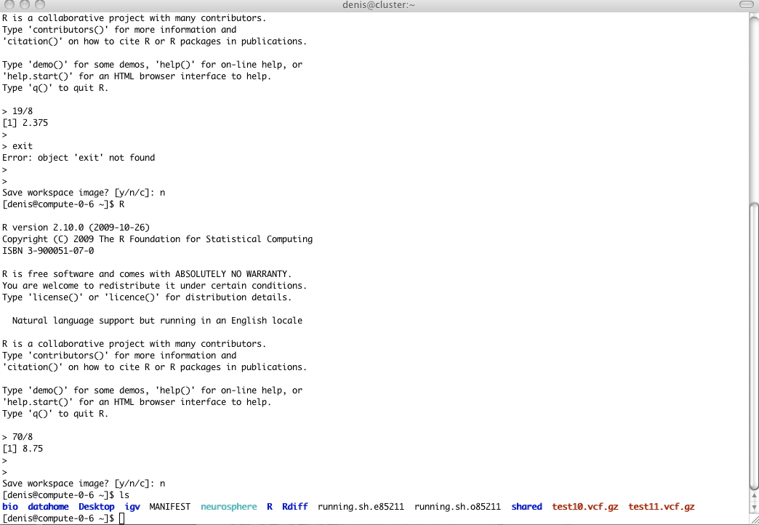
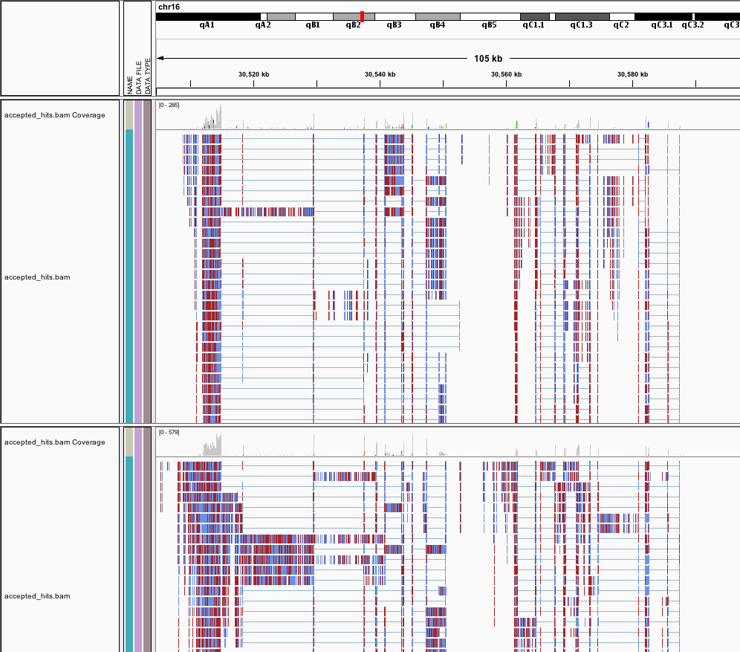
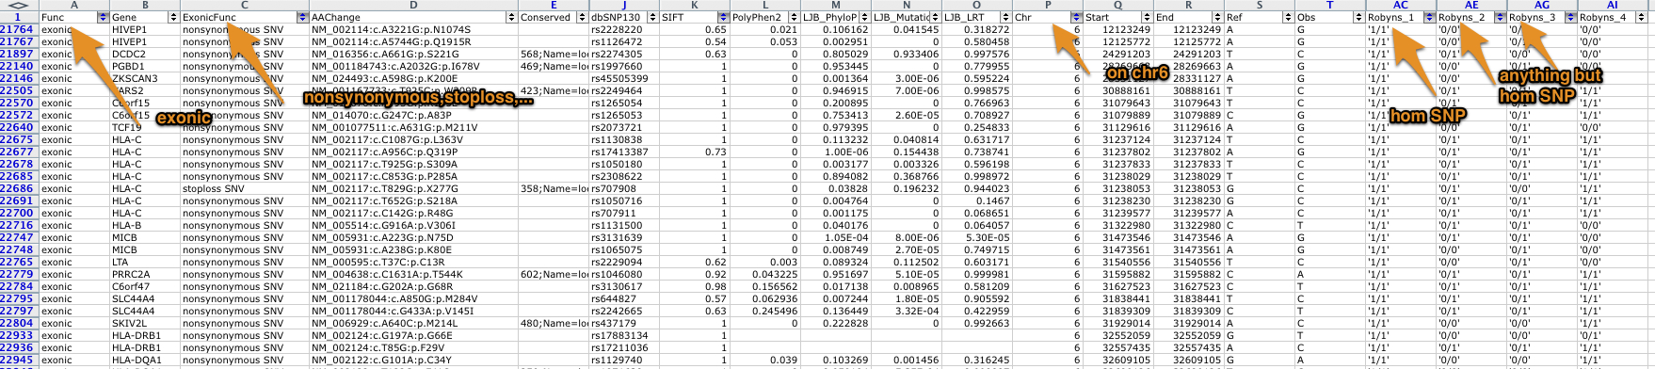
Download-free availability:
1
Website
2
Command line
3
Rstudio
4
Genome Viewer
5
Excel-like

Slide 15
Supported pipelines
# General
fastQC -- run fastQC
RUNTRIMMING -- trim to a certain read length $TRIMLENGTH
RUNDOWNSAMPLING -- downsample to a certain number of reads $READNUMBER
DOWNSAMPLE -- downsample to a certain coverage
DEPTHOFCOVERAGE -- depth of coverage calculation can take a certain $REF
# Variant calling
RUNMAPPINGBWA -- run bwa (paired and single ended)
RUNREALRECAL -- realign and recalibrate quality score of mapped reads
RUNVARCALLS -- variant calling either combined or separate ($VARPERFOLDER) of all samples
RUNANNOTATION -- run Annovar annotation
# mRNA seq
RUNTOPHATCUFF -- run tophat and cufflinks
RUNCUFFDIFF -- differential expression detection (not really automated)
#methylation
RUNMAPPINGRRBS -- run reduced representation mapping of bisulfid reads

Slide 16
Cluster organization
Reference resources
Hg18,hg19,b37
dbSNPv132
HapMap
Programs
Freeze/ Bwa, tophat, MACs, GATK, … (~25 programs)
Devel/ <- you can install programs into that other people can use
HiSeqInf
Trigger.sh
Program.sh scripts (~37 scripts)

Slide 17
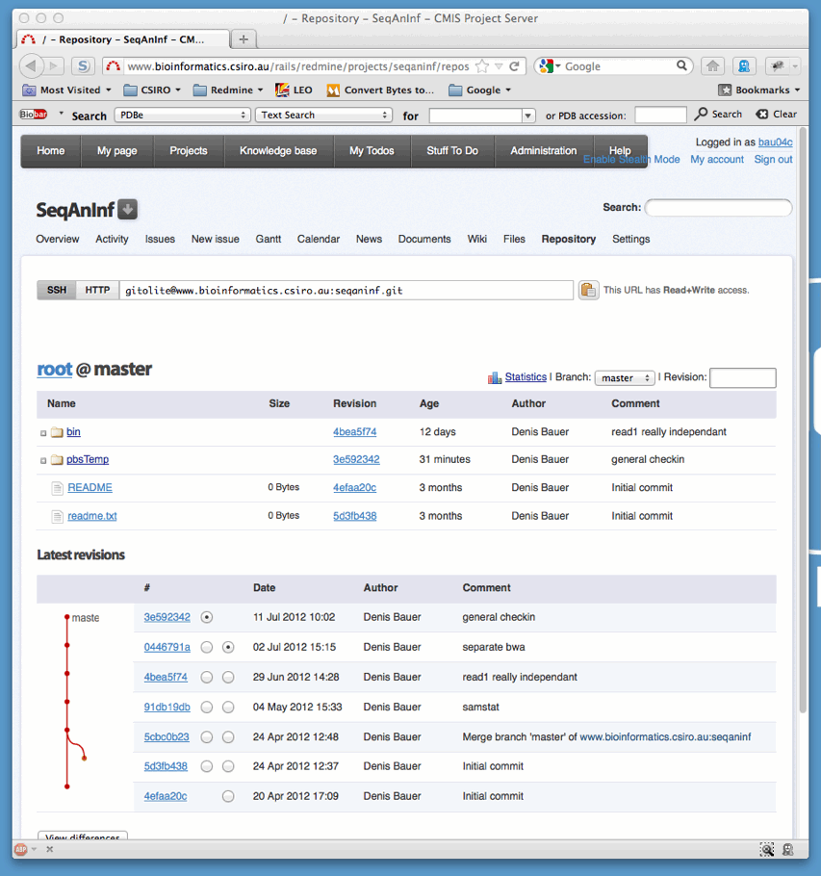
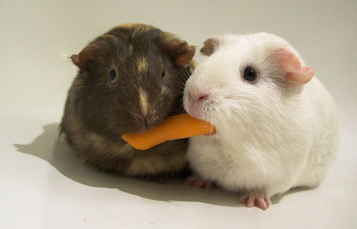
Version control of pbsscripts
Git repository on project server
[Photo Credit: ryancr]

Slide 18
Project Server
[Photo Credit: ryancr]
The way to plan and share research

Slide 19

Bad Practice
Back-up and share individual important files on group-share
Forget to upload latest version?
Need to recall how data was generated ?
Need a previous version ?
Broken or deleted a file ?
Find files ?
Sort out paths/programs ?
[Photo Credit: myconfinedspace]
Notes:
http://www.myconfinedspace.com/wp-content/uploads/2007/06/sinister-cat-line-up.jpg

Slide 20
Version Control via Git
Repository:
Redmine
Local Versions:
Neil
Rob
Mike

Slide 21
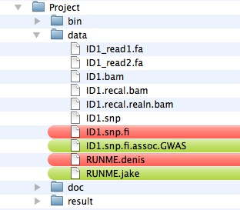
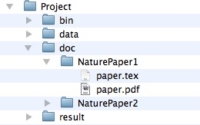
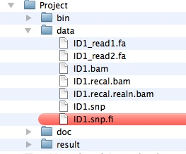
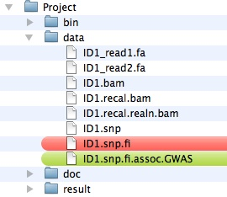
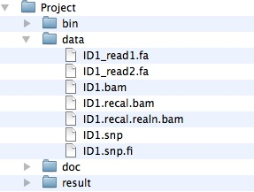
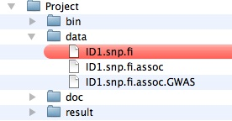
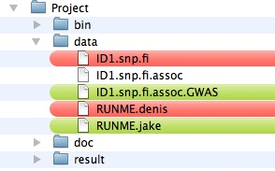
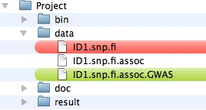
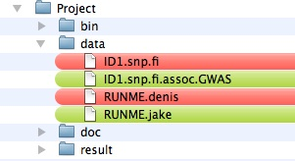
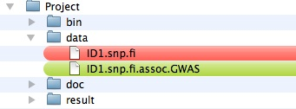
How to version control result files
Folder structure (denis)
Folder structure (bruce)
Folder structure (repository)

Slide 22


Research Workflow
Workflow
Identify long term goal (e.g. paper)
Identify task to achieve the goal in Meetings
Assign person to handle tasks
Record progress in the task
Add final result file to the version control to share
Write wiki/news article to summarize outcome
Benefits
back-up automatic,
Share scripts in the folder structure they were ,
Share outcome files within the folder structure,
Annotate files in our project server

Slide 23
The big picture
Covering all aspects of: design*, set-up*, maintenance*, usage
(*except cluster)
Documentation: Project Server
//project
7 project-cards
10 Projects, 6 HiSeq-Runs
40 wiki pages, 250 Tasks, 551h logged
5 TB raw data
750 GB processed data
57 GB external data
160 Commits
35 external programs
41 custom scripts (4197 lines of code)
Application
Data Warehousing
Backup/Version Control
Statistic
Analysis
RSudio
Raw Data
HiSeq Output
Quality Control
Project Cards
Processed Data
Processed Data
Rsync
Hypothesis Generation
Visualization
Software
BWA, GATK, samtools, etc.
IGV
Genome Browser
Custom Scripts
Version Control
Custom Scripts
Data
Processing and Analysis
Cluster
External Genomic Resources
Genomes, Annotation, etc.
Project Server
Content
Galaxy
//cluster-vm
//clusterstorage
//groupshare, //ethan

Slide 24
Thank you
CMIS
Denis C. Bauer Research Scientist
t +61 2 9325 3174
E Denis.Bauer@csiro.au
w www.csiro.au/cmis
CMIS

